Slide 1
Visualization
Tino Weinkauf

Slide 2
General
Tino Weinkauf weinkauf@kth.se Lindstedtsvägen 5, Room 4420
Office hours: by appointment (e-mail)
Website (Canvas): https://kth.instructure.com/courses/2491

Slide 3
General
Announcements, schedule, class material: https://kth.instructure.com/courses/2491
The lecture slides are available immediately after the lecture.

Slide 4
Registration
You have to register for the lecture
Grading (exercises, exam) requires registration
You are welcome to just sit in and listen
Registration is required for credits
You will be notified about the signup deadline by the university

Slide 5
PhD-students from other universities taking courses at CSC
In some courses at CSC there are PhD-students from other universities in Sweden following the course.
Since information, material and communication often is done via KTH systems and the student need a KTH-account to sign in these systems these students have had problems to attain the same information as the other students.
It is possible for external PhD-students to get a KTH-account: Go to the reception at CSC at Lindstedtsvägen 3, level 4, where you can sign a form.
It will only take a few days to get the account.

Slide 6
Funka
Disability
Support via Funka If you have a disability, you may receive support from Funka. https://www.kth.se/en/student/studentliv/funktionsnedsattning
Inform the teacher We recommend that you inform the teacher regarding any need you may have. Funka does not automatically inform the teacher.
Funktionsnedsättning
Om du har en funktionsnedsättning kan du få stöd via Funka: https://www.kth.se/student/studentliv/funktionsnedsattning Informera dessutom kursledaren om du har särskilda behov. Visa då upp intyg från Funka.

Slide 7
General
Lectures & Tutorials:
Monday
Wednesday
Thursday

Slide 8
Schedule (tentative)
Week | Monday 08:00 - 10:00 | Wednesday 10:00 - 12:00 | Thursday 13:00 - 15:00
Week 35 |  | Lecture #1 | Lecture #2, Hand-Out: Theory01
Week 36 | Lecture #3 | Coding Tutorial | Tutorial for Theory01, Hand-Out: Practice01
Week 37 | Lecture #4 | Lecture #5 | Interviews for Practice01, Hand-Out: Practice02
Week 38 | Lecture #6 | Lecture #7 | Interviews for Practice02, Hand-Out: Theory02
Week 39 | Lecture #8 | Lecture #9 | Tutorial for Theory02, Hand-Out: Practice03
Week 40 |  |  | Interviews for Practice03, Hand-Out: Practice04
Week 41 | Lecture #10 | Lecture #11 | Interviews for Practice04

Slide 9
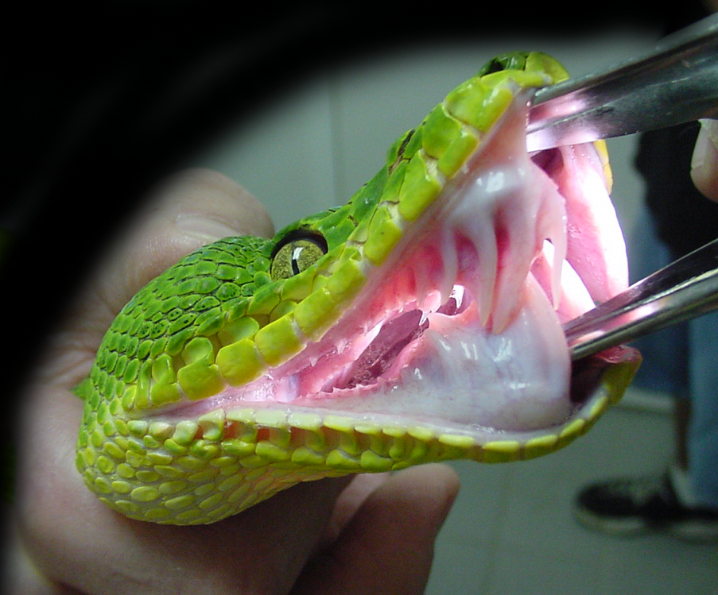
Oral Exams
(30 min)

Slide 10
Homework & Exam
To pass the lecture, you need to...
Work on all homework assignments
Obtain at least 50% of the assignments score
Pass the final oral/written exam == grade
Written: 2 hours
Date for the written exam:
October 27
Date for the re-exam:
tbd
7.5 CP

Slide 11
Assignments
Concept
Theory & practice: Alternating every other week
Exercises will be posted online
Theoretical Assignments
Each student must prepare a write-up
Hand-in solutions: before the tutorial (after one week)
Will be returned a week later
Solutions will be discussed in the tutorial course

Slide 12
Practical Assignments
Practical Assignments
Programming assignments
Every other week, instead of theory
Group work: groups of three students
A C++/QT framework will be provided (Linux/Windows)
Windows users: Visual Studio Express is available for free download
Linux users: Multiple options: Console, K-Develop, QT Creator

Slide 13
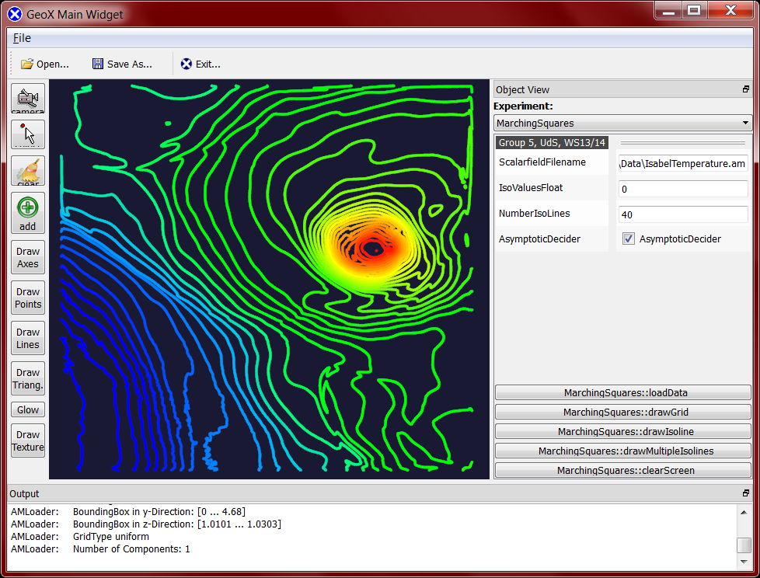
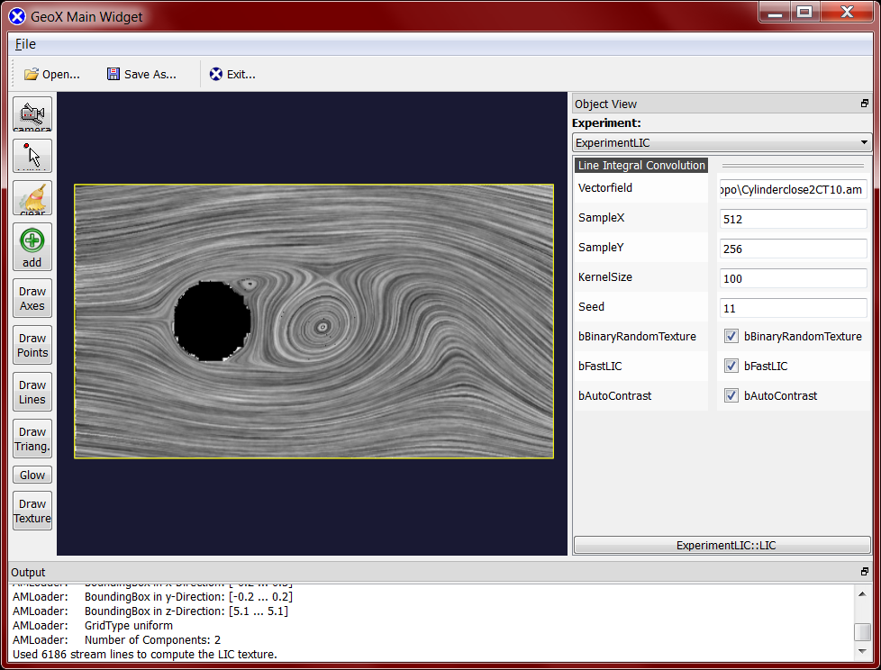
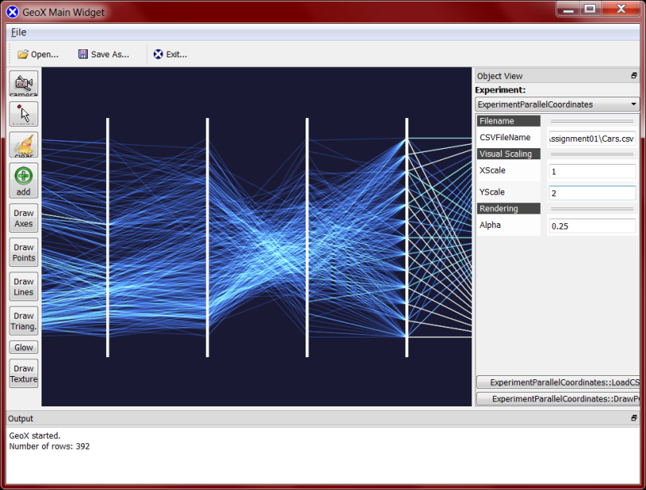
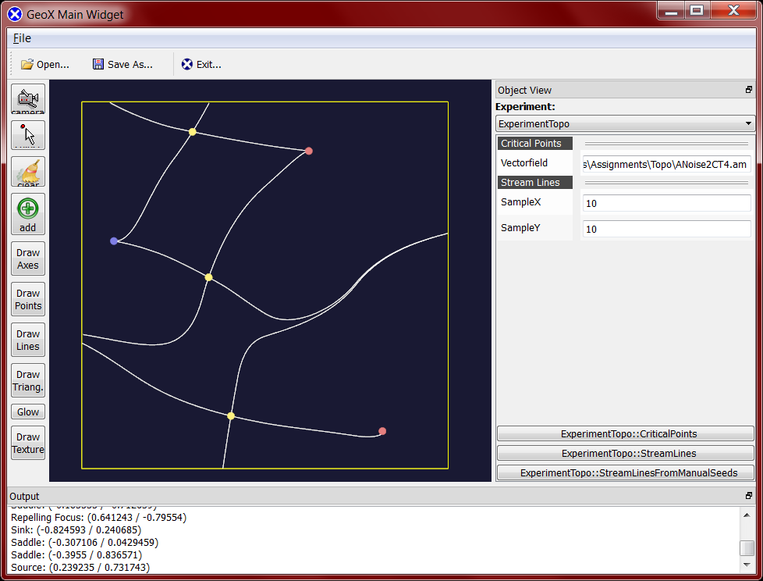
Examples of Practical Homework
Marching Squares
Line Integral Convolution
Parallel Coordinates
Vector Field Topology

Slide 14
Practical Assignments
Practical Assignments: Grading
Grading by TAs in interviews
Group must show up entirely
In TAs office
Option to get individual time slots
Everybody is graded individually, based on:
The group’s implementation
Personal knowledge about the implementation
Everybody must be able to explain all of the code

Slide 15
Practical Assignments
Practical Assignments
Groups of three students
Form groups yourselves
Let Wiebke know: Email: wiebkek@kth.se
Deadline: September 7
Bring your own equipment (laptop)
Possible for everyone?

Slide 16

Teaching Assistant
Wiebke Köpp
wiebkek@kth.se
LV 5, Room 4424

Slide 17
Practical Assignments
First Tutorial course (September 6):
Using the programming environment (personal advice)
Introduction to the provided C++ framework
Help with forming groups
Bring your laptop!

Slide 18
Evaluation
Questions & Suggestions
Please let us know if there are any issues anytime
We appreciate your feedback! Please let us know:
...if you find a certain part of the lecture hard to understand or not well explained.
...any suggestions how to improve the lecture or the exercises.
...any other questions, suggestions or concerns.
Office hours: Appointments can be coordinated via e-mail

Slide 19
Acknowledgements
The script of this class contains parts of the following scripts:
Prof. Heidrun Schumann (University of Rostock, Germany)
Prof. Helwig Hauser (University of Bergen, Norway)
Prof. Holger Theisel (University of Magdeburg, Germany)
Prof. Rüdiger Westermann (TU Munich, Germany)
Prof. Ronald Peikert (ETH Zürich, Switzerland)
Prof. Thomas Schulz (University of Bonn, Germany)
Prof. Bernhard Preim (University of Magdeburg, Germany)
Prof. Miriah Meyer (University of Utah, U.S.A.)
Prof. Jens Krüger (University of Duisburg/Essen, Germany)
Thank you!

Slide 20
Literature
Alexandru Telea, Data Visualization: Principles and Practice, A K Peters Ltd, 2007, ISBN 978-1568813066, 502 pages
Charles Hansen and Chris R. Johnson (eds.), The Visualization Handbook, Academic Press, 2004, ISBN: 978-0123875822, 984 pages
Proceedings of IEEE Visualization Conferences
Proceedings of EuroVis/VisSym

Slide 21
Literature
K. W. Brodlie et al. (eds.): Scientific Visualization - Techniques and Applications, Springer 1992
R. A. Earnshaw, N. Wiseman (eds.): An Introductory Guide to Scientific Visualization, Springer, 1992
P. Keller, M. Keller: Visual Cues, IEEE Computer Society Press, 1993
L. Rosenblum et al. (eds.): Scientific Visualization, Academic Press, London, 1994
H. Hearnshaw, D. Unwin: Visualization in Geographical Information Systems, John Wiley & Sons, Chichester, 1994
G.M. Nielson; H.Hagen; H.Müller: Scientific Visualization, IEEE Computer Society Press, Los Alamitos, 1997

Slide 22
Get to know each other
Tino Weinkauf
Studied computer science in Rostock, Germany
Special focus: computer graphics and visualization
Worked at Zuse Institute Berlin, Germany (2001 – 2009).
Flow analysis and visualization
Received PhD in computer science (Dr. Ing.) from University of Magdeburg, Germany (2008).
Post-doc at New York University, U.S.A. (2009 – 2011)
Feodor Lynen fellowship from the Alexander von Humboldt foundation
Head of independent research group at Max-Planck-Institute for Informatics, Saarbrücken, Germany (2011 – 2014)
Professor of Visualization, KTH Stockholm (since 2015)
Research interests: Visualization, Data Analysis, Computer Graphics, Topology, Geometric Modeling, Shape Analysis

Slide 23
And you?
Name
Where do you come from?
Where did you do your Bachelor?
In what program are you now?
Master Computer Science
Master Machine Learning
Master HCI
Master Media Management
Master Media Technology
Something else?

Slide 24
Covered Topics
Introduction
Data Description, Interpolation and Selection
Mapping of Data to Graphics
Tree/Graph Visualization
Multidimensional Visualization
Volume Visualization
Flow Visualization
Feature-based Visualization
Topological Data Analysis

Slide 25
Introduction
Problem Description

Slide 26
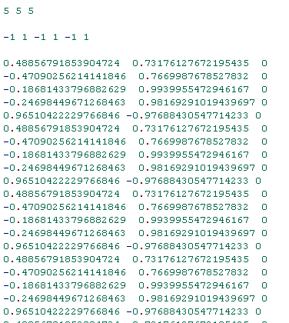
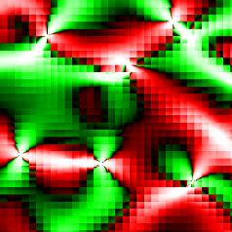
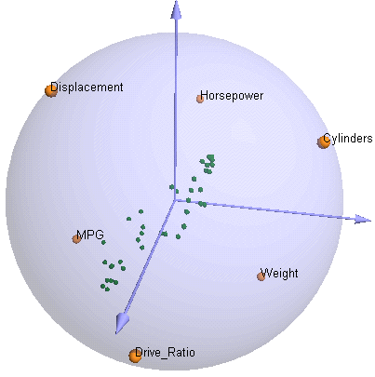
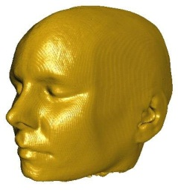
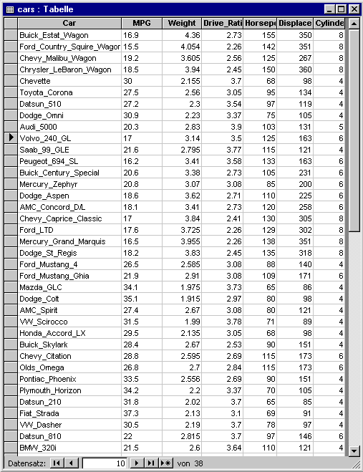
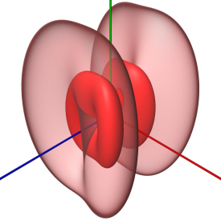
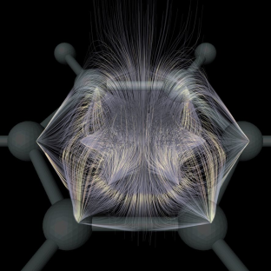
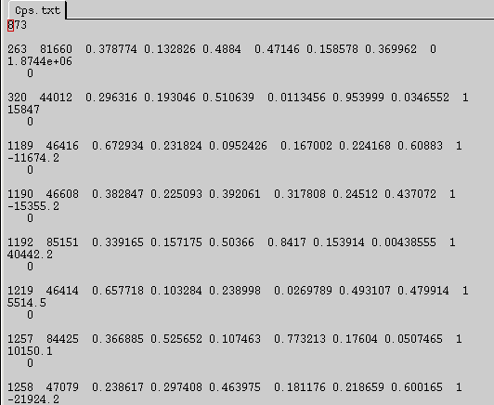
Introduction: Problem Description
Visualization
large
complex
various structures

Slide 27
Introduction: Problem Description
„Visualization“ means to find an appropriate visual representation for a given (large) data set in order to allow a more effective analysis and evaluation of the data.

Slide 28
Introduction: Problem Description
Aim:
not only see the data but gain understanding and insight into the data
show what is really going on inside the data,
reveal important structures and correlations in the data
Motivation:
human eye is able to recognize a high amount of data instantaneously

Slide 29
Introduction: Problem Description
Visualization simplifies
the analysis,
the understanding and
the communication
of
models,
concepts and
data
in science and engineering.

Slide 30
Introduction: Problem Description
This means, Visualization
provides appropriate visual representations for the scientist
shows inner correlations of the data which were lost otherwise, and
supports the exchange of exploration results

Slide 31
Introduction: Problem Description
Visualization is used in 3 ways:
Explorative analysis Given: Data without hypotheses about them Process: interactive search for information, usually by chance Results: Visualization which supports a hypothesis on a data set
Confirmative analysis Given: Hypothesis about data Process: Specific checking of hypothesis Result: Visualization which supports verification/falsification of a hypothesis
Presentation Given: already known facts Process: Recognizing these facts Results: Visualization which emphasizes the facts

Slide 32
Introduction: Problem Description
Data Acquisition There are three principal data sources:
real world (measuring instruments provide data, such as CT scanner or satellite images)
theoretical world (computations based on mathematical models, such as molecule modeling and meteorology)
artificial world (human creates data, for instance in art, television, film)

Slide 33
Introduction
History

Slide 34
Introduction: History
Idea of visualization very old
Euclid’s ”Elements”: drawings to represent and illustrate properties in geometry.
Middle Ages: astronomical maps with arrow plots to visualize prevailing winds over the oceans.
18th century: height lines used in topographical maps

Slide 35
Introduction: History
Alexander von Humboldt (German scientist and explorer, 1769 – 1859) Investigations of temperature gradients on the northern hemisphere. (1817)
René Descartes (French philosopher, mathematician, physicist, 1596 – 1650) ”Imagination or visualization, and in particular the use of diagrams, has a crucial part to play in scientific investigations”. (1637)

Slide 36

1869 Cartography by Charles Joseph Minard
Napoleons campaign against Russia (1812/13)
Notes:
Napoleon verbündete sich mit Preußen und Österreich und bildete die bisher größte Armee der Geschichte. Russland verbündete sich mit Schweden und beendete den Krieg mit Türkei. Juni 1812 Überschreitung des Njemen. Linker Flügel operiert zur Flankensicherung. Kutusow weicht Entscheidungsschlachten aus und entschließt sich zur beweglichen Verteidigung. Nach Einmarsch in Moskau verbrennen die Einwohner die Nahrungsmittelvorräte. Rückzug der immer kleiner werdenden Armee. Zusätzliche Tote durch Hunger, Kälte und Krankheiten.

Slide 37
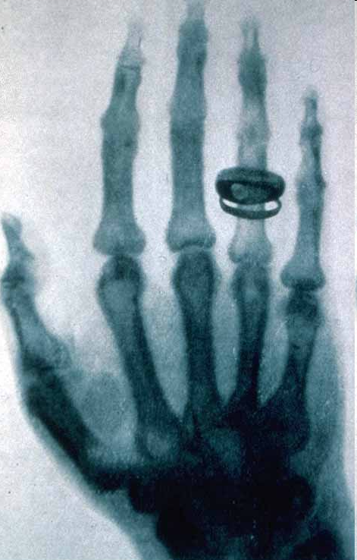
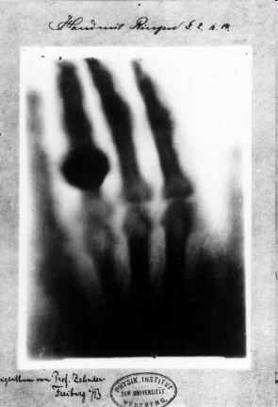
Introduction: History
Wilhelm Conrad Röntgen (German physicist, 1845 – 1923) X-rays (1895) first Nobel Prize in Physics (1901)

Slide 38
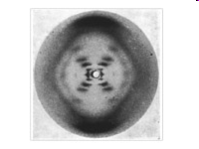
Introduction: History
Rosalind Franklin (British biophysicist, 1920 – 1958) X-ray diffraction images of DNA (1952)
Photo 51 X-ray diffraction image of sodium salt of DNA. B configuration
Nobel prize went to Watson, Crick, and Wilkins in 1962

Slide 39

Introduction: History
NASA: Experimental flow visualizations (1970s)

Slide 40
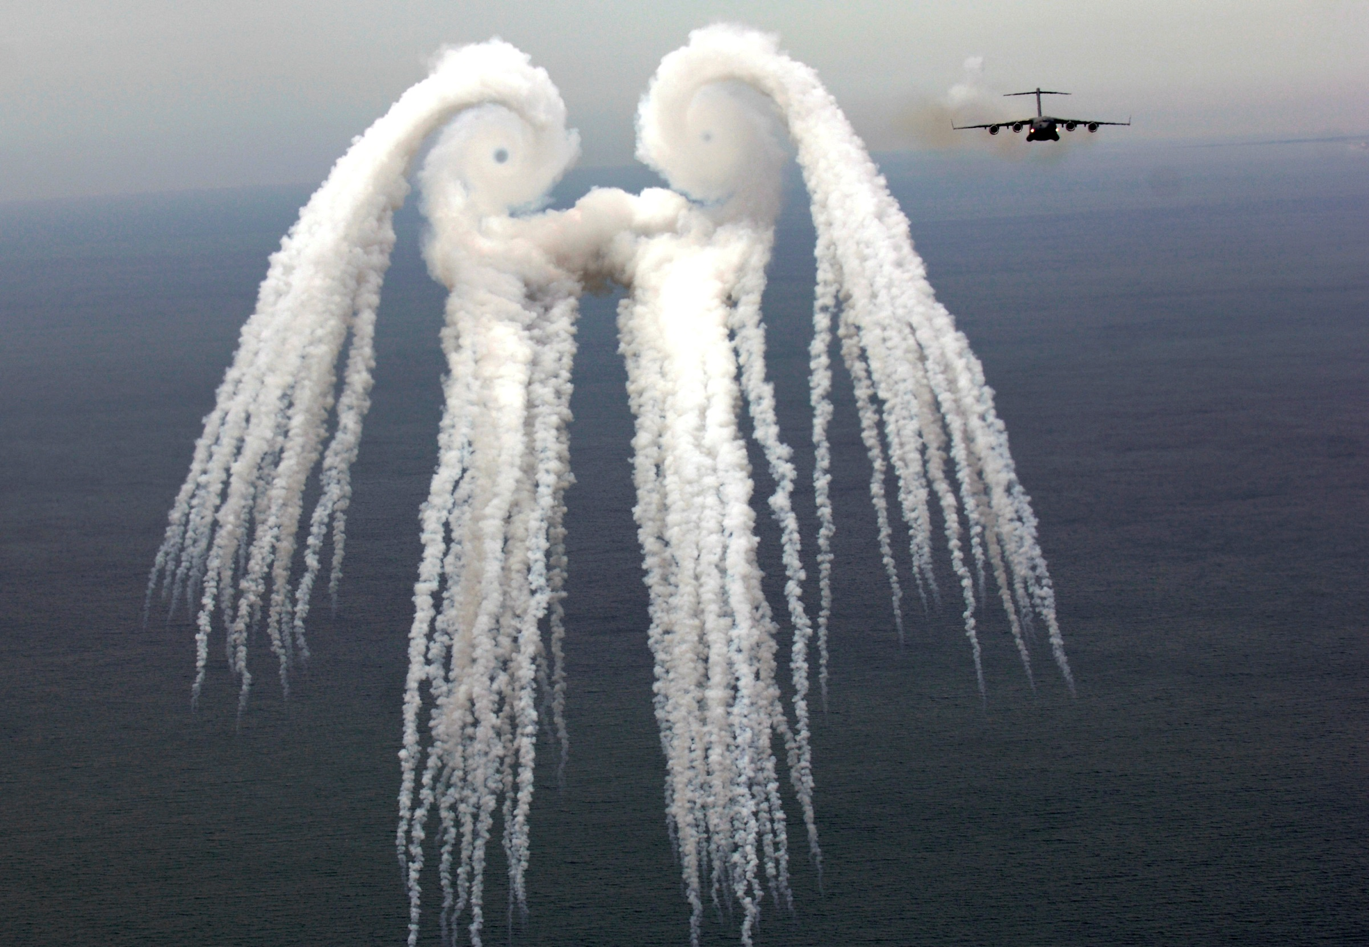
Smoke angel
A C-17 Globemaster III from the 14th Airlift Squadron, Charleston Air Force Base, S.C. flies off after releasing flares over the Atlantic Ocean near Charleston, S.C., during a training mission on Tuesday, May 16, 2006. The "smoke angel" is caused by the vortex from the engines. (U.S. Air Force photo/Tech. Sgt. Russell E. Cooley IV)

Slide 41
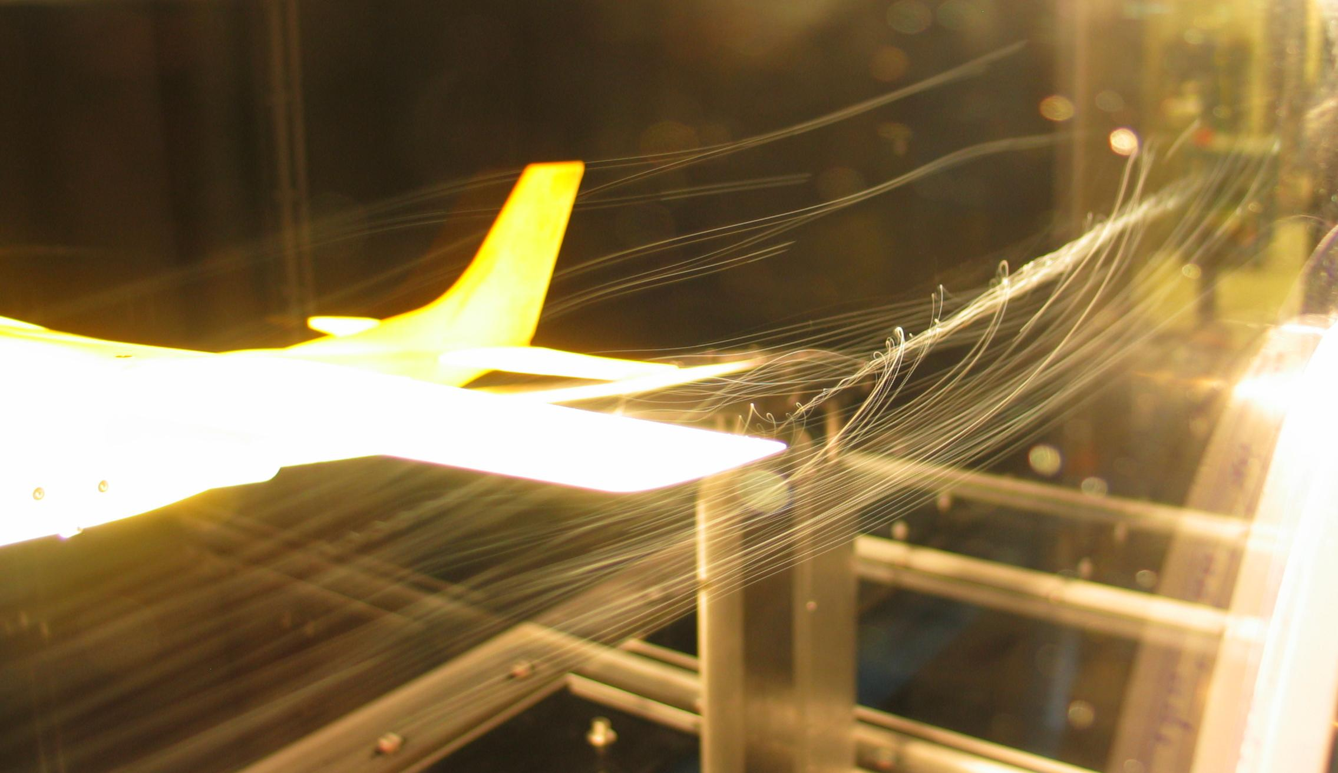
Introduction: History
A wind tunnel model of a Cessna 182 showing a wingtip vortex. Tested in the RPI (Rensselaer Polytechnic Institute) Subsonic Wind Tunnel. By Ben FrantzDale (2007).

Slide 42
Introduction: History
upcoming computer technology: new challenges!
virtual experiments, where the real ones are too expensive or dangerous
larger data sets
new opportunities to create visual representations (Computer Graphics)
1987: Visualization becomes discipline of its own
1987 Marching Cubes
1987 Parallel Coordinates
1989 Vector Field Topology
1993 Line Integral Convolution

Slide 43
Introduction: History
Since 1990: annual IEEE Visualization Conference
Since 1999: annual Eurographics Symposium/Conference on Visualization (EuroVis)
journals, books...
many research groups worldwide, strong funding

Slide 44
Data Explosion
Global data volume (stored) at the end of 2009: ➔ 800 exabytes
Square Kilometre Array (SKA)
Radio telescope under development in Australia and South Africa
Total collecting area of approximately one square kilometer
Fully operational by 2024
construction begins 2016
initial observations begin 2019
IBM expects more than 1 exabyte of information every day
Notes:
The domains in which data is expanding range from computer-aided design and manufacturing to arts and entertainment to intelligence analysis. The most effective way people have to comprehend and communicate the overall implications relies on computer graphics. Clear examples from specific domains show the effectiveness of interactive, real-time 3D graphics.

Slide 45
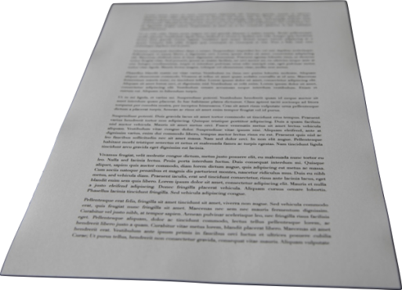


Data Explosion
Kilobyte 1,000 bytes, 10³
Megabyte 1,000,000 bytes, 10⁶
Gigabyte 1,000,000,000 bytes, 10⁹

Slide 46
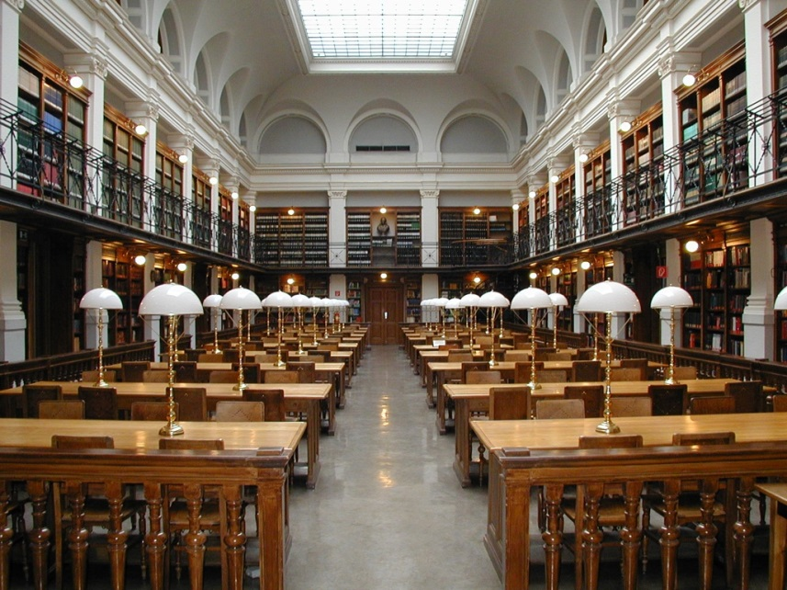
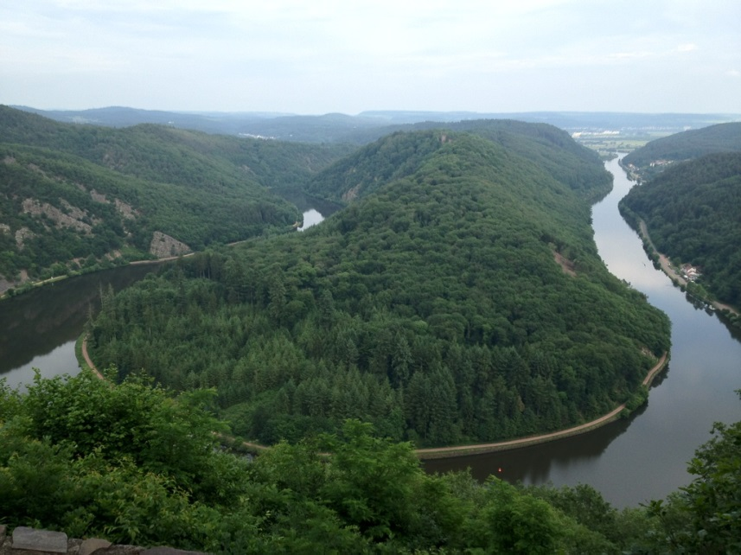
Data Explosion
Terabyte 1,000,000,000,000 bytes, 10¹²
1-2 TB: An academic research library
50,000 trees made into paper
Notes:
1-2 TB: An academic research library
OR
50,000 trees made into paper

Slide 47


Data Explosion
Petabyte 1,000,000,000,000,000 bytes, 10¹⁵
200 PB: All printed material
4 PB: A human life
(87 years of 1080p HD recording,
Blu-Ray encoding)
Notes:
4 PB: a human life (87 years of 1080p HD recording, Blu-Ray encoding) OR
200 PB: All printed material

Slide 48
Data Explosion
Petabyte 1,000,000,000,000,000 bytes, 10¹⁵
Transistor Count
(Performance)
Performance
1999
Today
Time
1999
Today
Time
Moore’s Law
“Darwin’s Law”
Today, a simulation on a supercomputer can yield up to a few petabyte.
4 PB: A human life
(87 years of 1080p HD recording,
Blu-Ray encoding)
Notes:
Darwin’s law for the growth of human capability has actually stayed constant for tens of thousands of years, and it doesn’t look like there will be a significant rise in our capability in the foreseeable future.
On the other hand, the growth in technology is producing data at rates faster than any time in history. Gutenberg’s printing press had a profound effect on the population and forced people to become literate. Technology allows us to store and retrieve lots more data (both textual and visual) lots faster. We can process the data more efficiently. And we can display the data on many more devices with large and small screens than ever before.

Slide 49
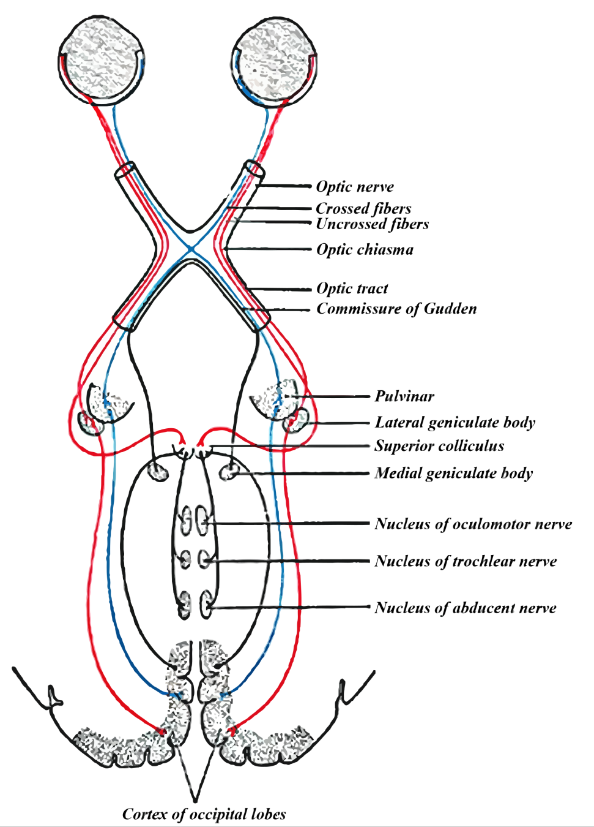
The Human Visual System
Information
aggregate
filter
visualize
Visual System
understand

Slide 50
Introduction
Requests on a Visualization

Slide 51
Introduction: Requests on a Visualization
(Schumann)
The visualization of a data set should be:
expressive
effective
appropriate

Slide 52
Introduction: Requests on a Visualization
Expressiveness: A visualization is expressive, if (only) the information is represented which is in the data.
Non-expressive visualization
Expressive visualization

Slide 53
Introduction: Requests on a Visualization
Effectiveness: A visualization is effective if the visual representation supports the spontaneous perception. The effectiveness criteria contains psychological aspects, such as the intuitiveness of the representation and the visual perception of the elements and their correlations.
Non-effective visualization

Slide 54
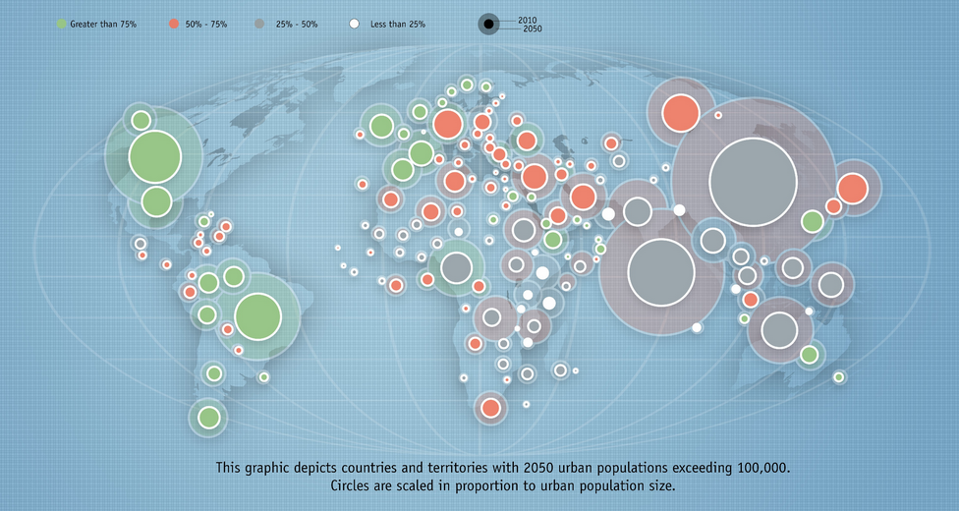
Introduction: Requests on a Visualization
Effectiveness: A visualization is effective if the visual representation supports the spontaneous perception. The effectiveness criteria contains psychological aspects, such as the intuitiveness of the representation and the visual perception of the elements and their correlations.
Non-effective visualization

Slide 55
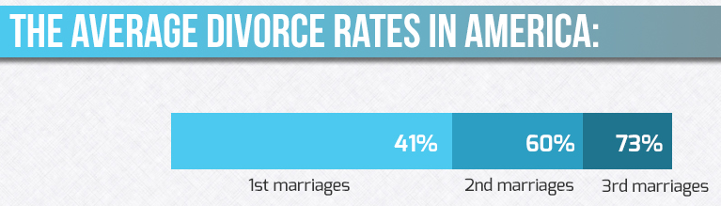
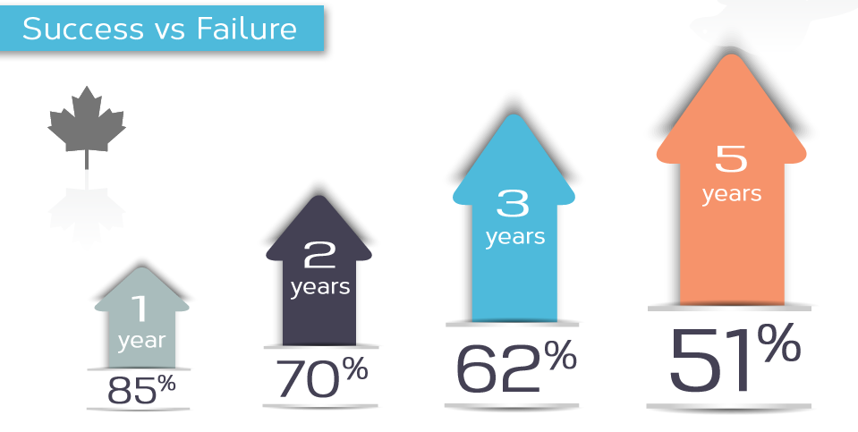
Introduction: Requests on a Visualization
Effectiveness: A visualization is effective if the visual representation supports the spontaneous perception. The effectiveness criteria contains psychological aspects, such as the intuitiveness of the representation and the visual perception of the elements and their correlations.
Non-effective visualizations

Slide 56
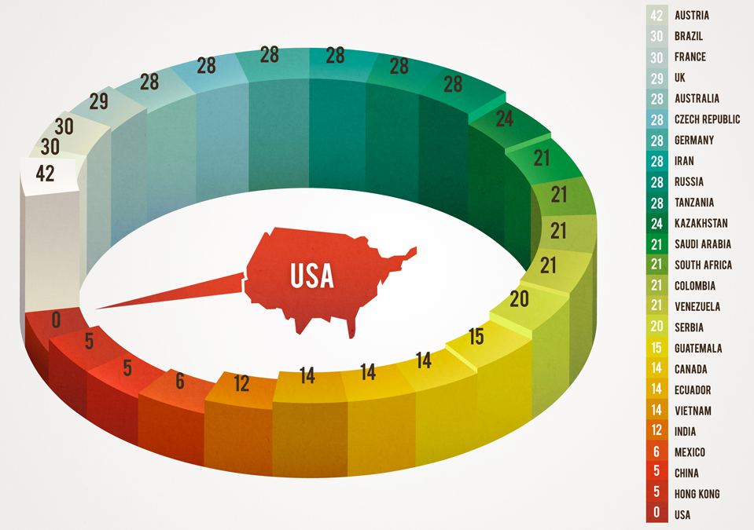
Introduction: Requests on a Visualization
Appropriateness: A visualization is appropriate if it has a good cost – benefit ratio.
Not appropriate visualization

Slide 57
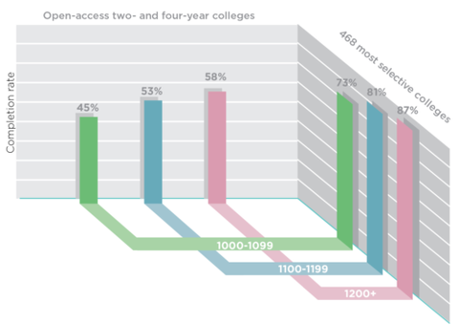
Introduction: Requests on a Visualization
Appropriateness: A visualization is appropriate if it has a good cost – benefit ratio.
Not appropriate visualization

Slide 58
Introduction
How (Not!) to lie with visualization

Slide 59
Introduction: How (Not!) to lie with visualization
Parts of a lecture by Chris North, Virginia Tech

Slide 60
Stock Market Crash?!
Market
$9000
8875
8750
8625
8500
1995 1996 1997 1998 1999 2000

Slide 61
Showing entire scale
Market
$10,000
7500
5000
2500
0
1995 1996 1997 1998 1999 2000

Slide 62
Shown in context
Market
$10,000
7500
5000
2500
0
1950 1960 1970 1980 1990 2000

Slide 63
Tufte’s Rule
Visual attribute value should be directly proportional to data attribute value
Lie factor = (visual effect) / (data effect)
truth = 1.0

Slide 64
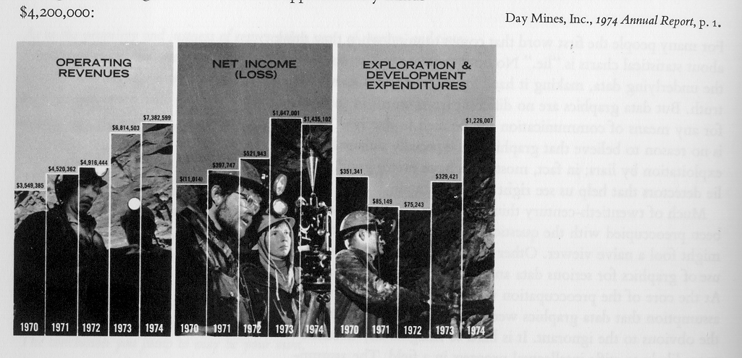
Company financial status

Slide 65
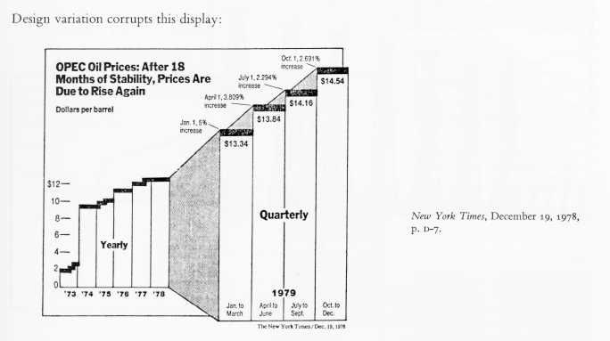
Changing Scale
0.5?
13

Slide 66
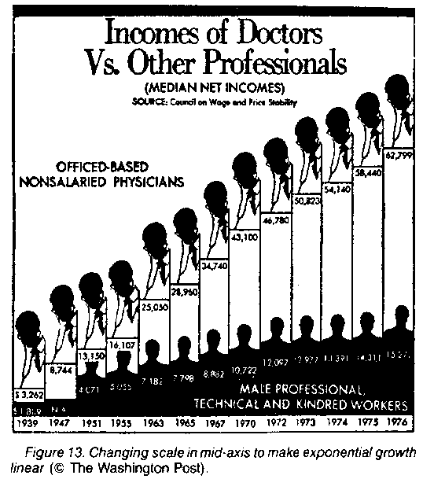
Changing Scale

Slide 67
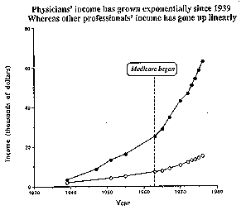
…with linear time scale

Slide 68
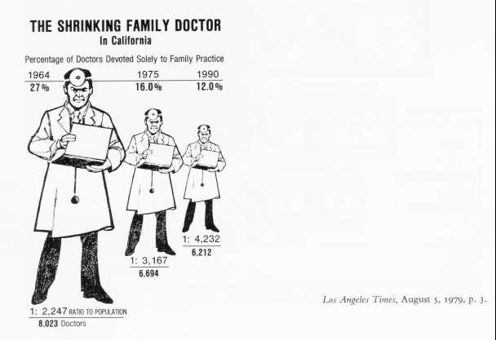
Size Encoding

Slide 69

Size Encoding: height or area?
=
?

Slide 70
Size Encoding

Slide 71
Height or Area
Height = value Width = value Area = value²
or
Area = value height*width = value height = width = value ^{0.5}
Problem:
Using 2 dimensions to
represent 1 dimension.

Slide 72
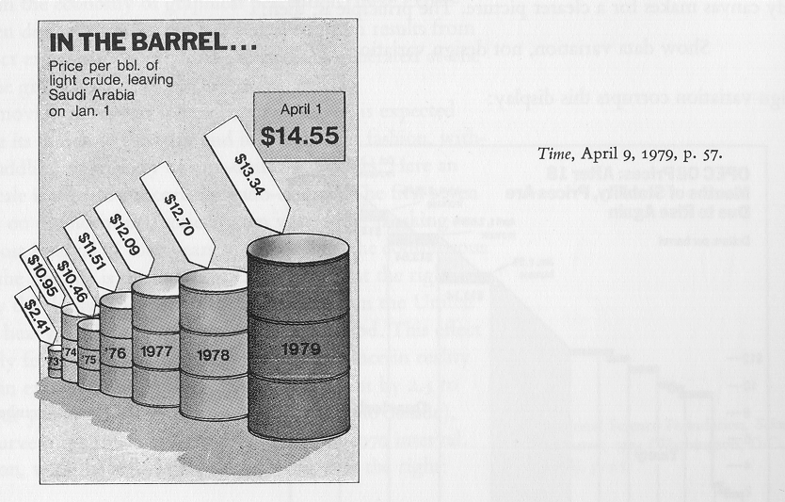
Volume encoding?
Height?
Diameter?
Surface area?
Volume?
73 – 79 data difference = 5.5x
73 – 79 volume difference = 270x

Slide 73
Problem with size encoding
1 2 3 4 5 6 7
Height
Area
Volume

Slide 74
Height & width encoding
1 2 3 4 5 6 7
Height
Height & Width

Slide 75
Solution: just use height

Slide 76
Size Encoding

Slide 77
How not to lie
Show entire scale
Show data in context
Consistent, linear scale
Log scale for log data
Up vs. down: indicate direction of improvement
Avoid size encoding
Use height OR width
Don’t use both for same data attribute
Avoid area, volume encoding

Slide 78
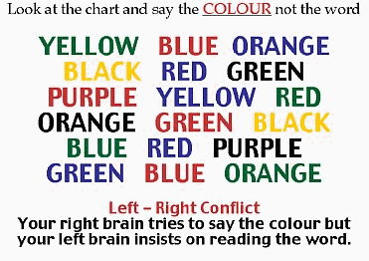
Verbal-visual conflict

Slide 79
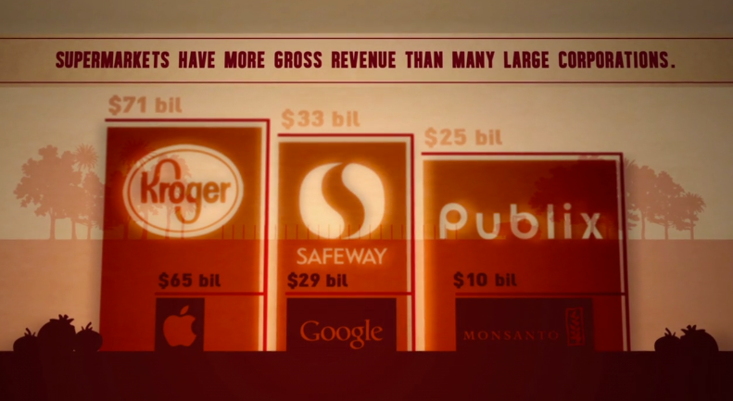
For more, see http://wtfviz.net/

Slide 80
Introduction
Examples and Applications

Slide 81
Introduction: Examples and Applications
The human brain can analyze and understand visual data very fast – faster than any other sense. Thus there is a variety of applications.
molecule modeling – visualization of molecule structures
medical imaging
fluid dynamics
environmental analysis and planning
astrophysics
biology
geo-sciences
engineering
much more

Slide 82
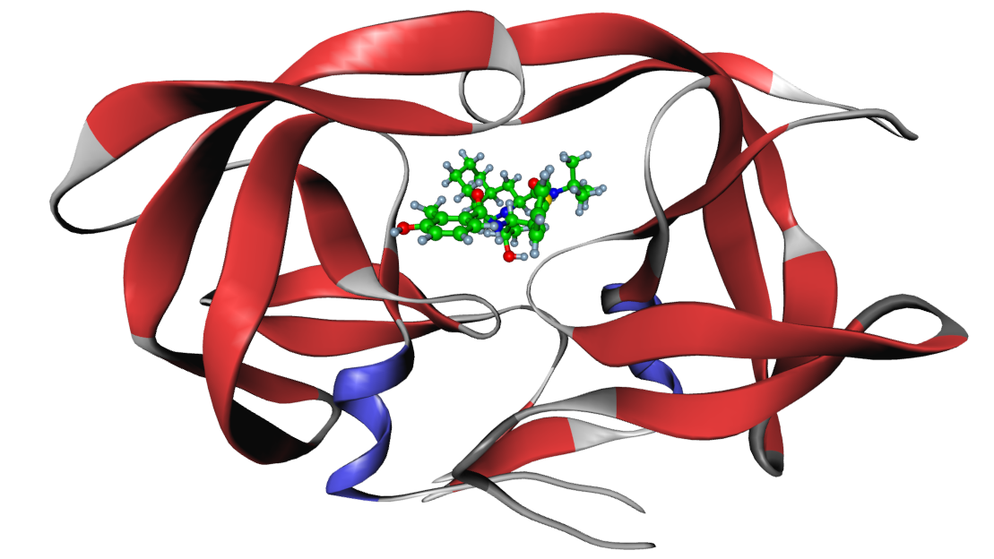
Molecular Visualization
Daniel Baum (Zuse Institute Berlin)

Slide 83

Molecular Visualization
Understanding the complex structures in molecules
Understanding the dynamics of molecules
Understanding the docking properties of molecules
Understanding the relationships between molecules
…
➔ Design of new drugs
Two conformations of a molecule that can be found in green tea
Johannes Schmidt-Ehrenberg, Daniel Baum (Zuse Institute Berlin)

Slide 84
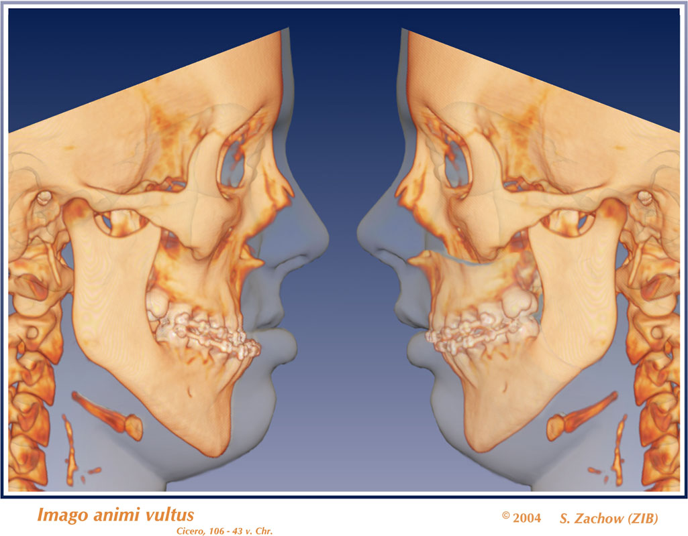
Medical Visualization

Slide 85
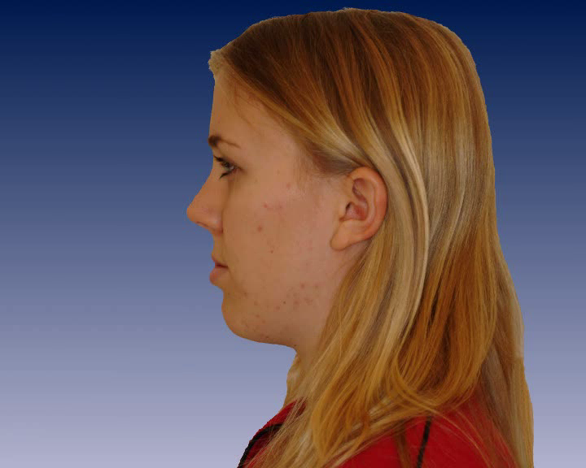
Medical Visualization
Medical visualization leads to surgery planning
Stefan Zachow (Zuse Institute Berlin)

Slide 86
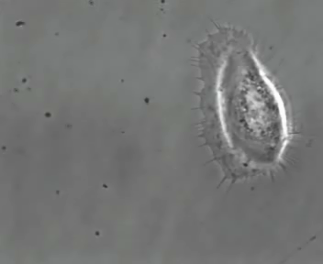
Cell Biology
In cooperation with MPI Biochemie, Martinsried
Dr. A Rigort, Prof. Dr. W. Baumeister
Moving cell

Slide 87
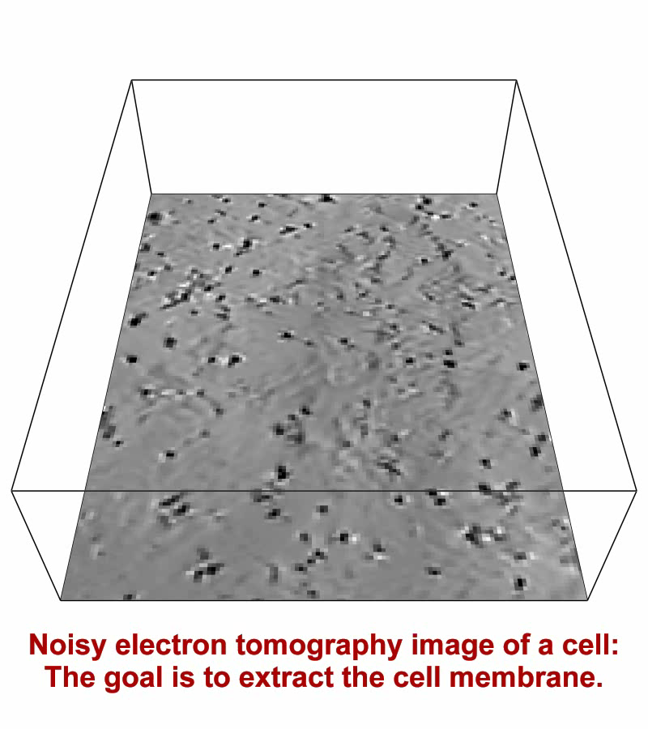
Cell Biology

Slide 88
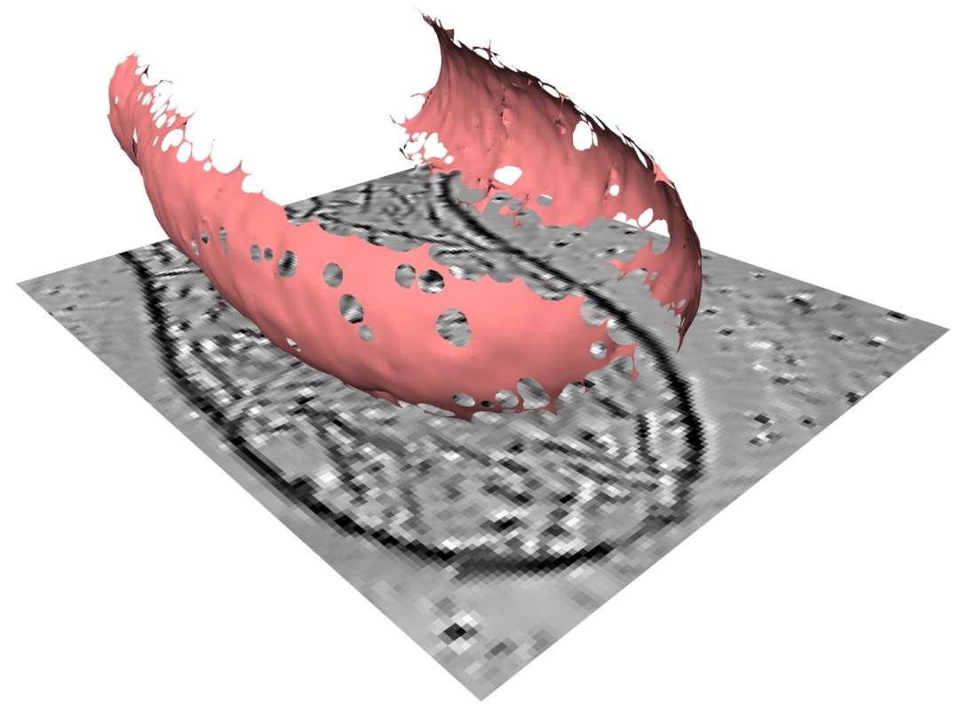
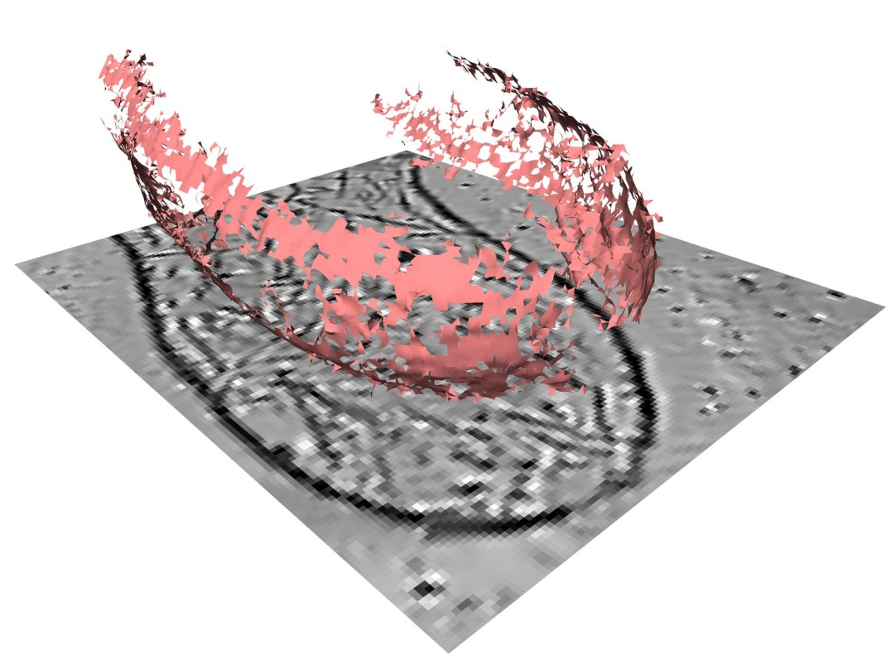
Topology
Separatrix Persistence
Ridge surface
Original data
from electron tomography

Slide 89
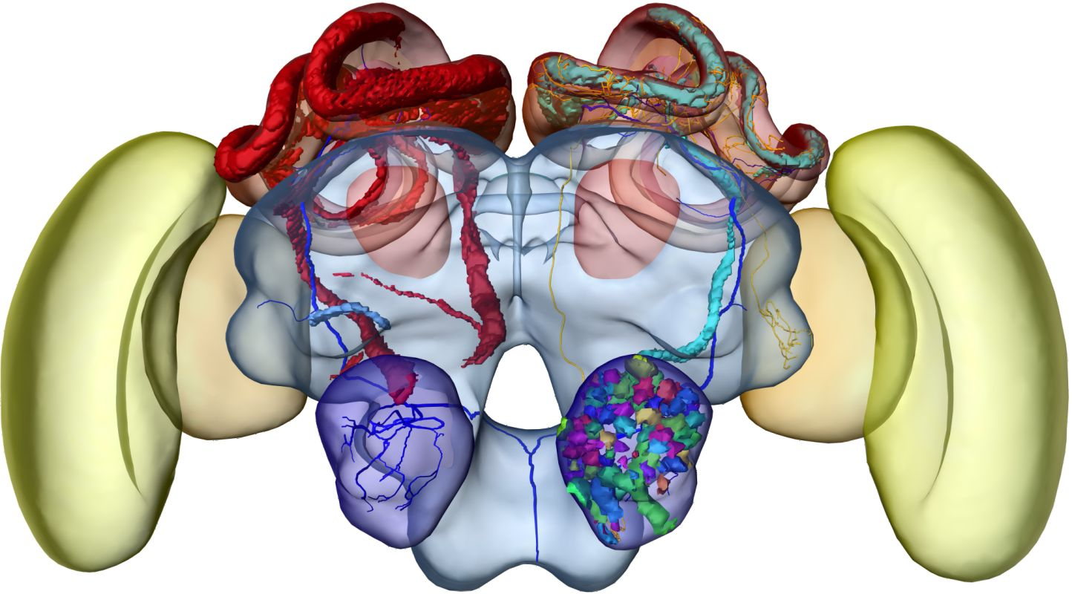
Visualization in Biology
The brain of a honeybee has been segmented into its functional parts.
The goal is to create a functional atlas of the brain.
Anja Kuß, Alexander Maye (Zuse Institute Berlin)

Slide 90
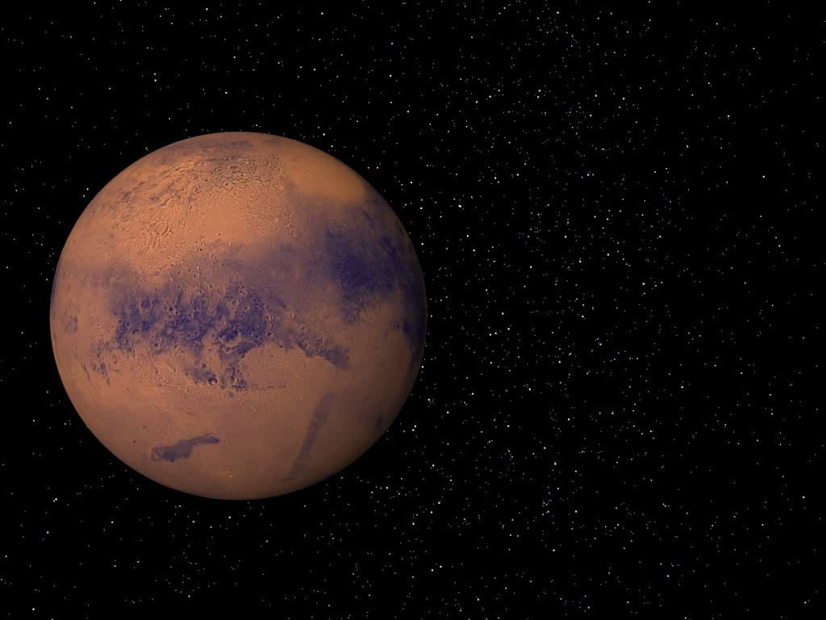
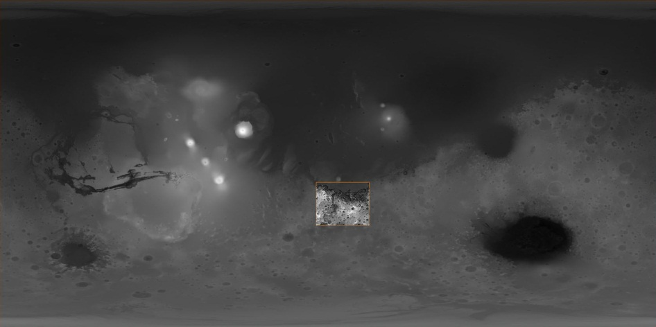
Rivers on Mars
NASA Mars Global Surveyor
Launch: November 7, 1996
Mission: Mapping of Mars
Time: 4.5 years
Mars Orbiter Laser Altimeter
Determines the height of surface features on Mars
640 million elevation measurements
Global grid with 200m at equator; less elsewhere
Accuracy: 2-13m
Mars Orbiter Laser Altimeter
Determines the height of surface features on Mars

Slide 91
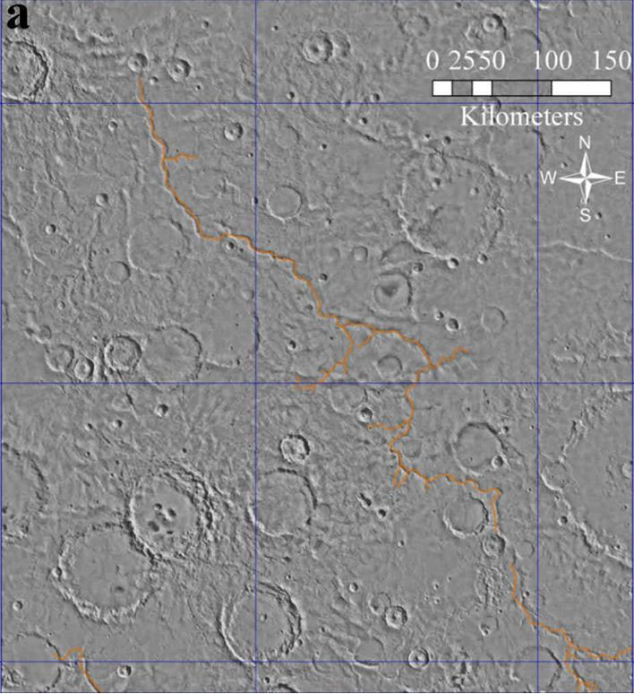
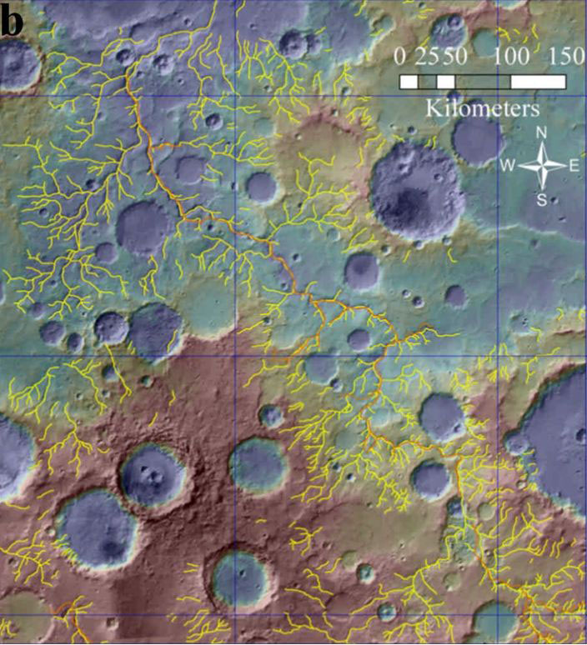
Objective: Extract river networks on Mars
Previous Methods: mostly manual
Manual mapping of networks
[Carr, J. Geophy. Research, 1995]
Valleys based on derivatives
& manual curation
[Hynek et al., Geology, 2003]

Slide 92
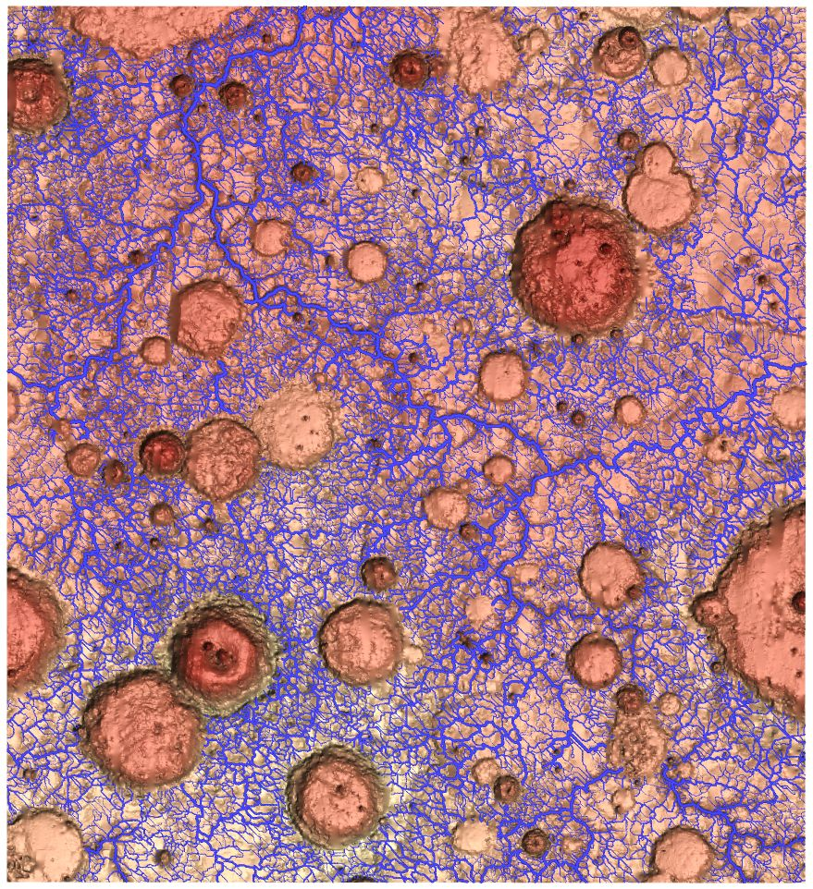
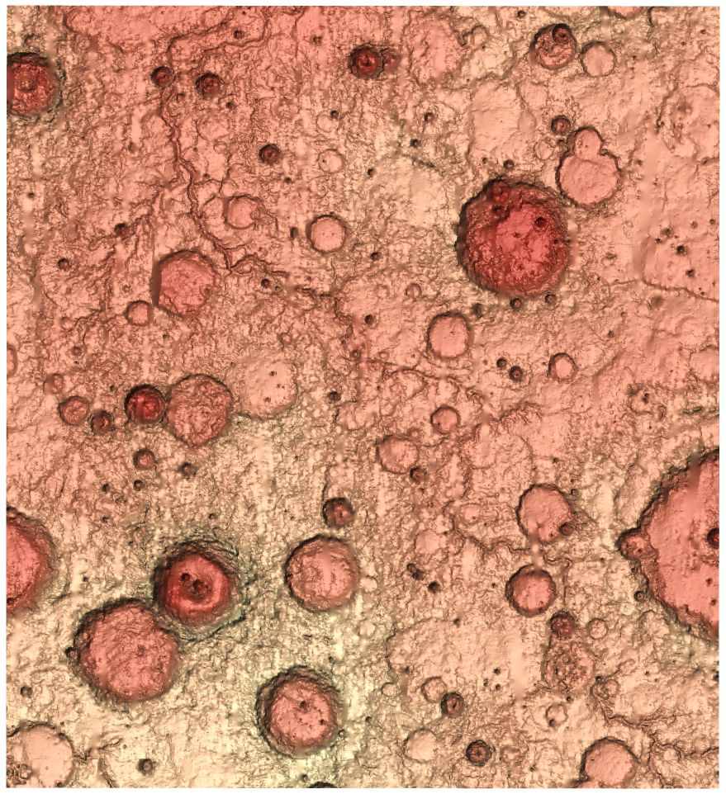
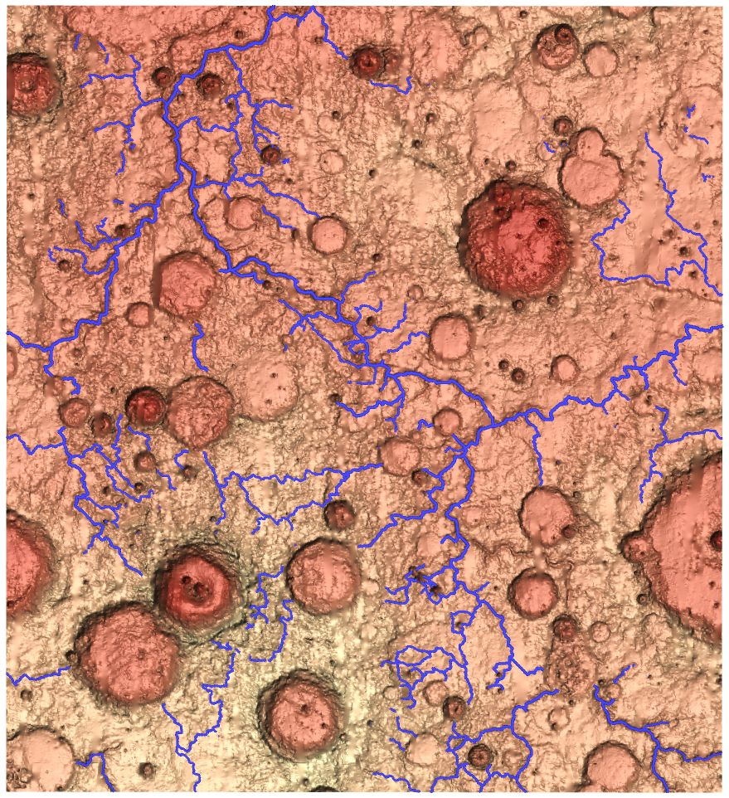


Objective: Extract river networks on Mars
Joint work with Patrick McGuire (U Chicago) and Sebastian Walter (FU Berlin)
Extract topology and filter lines using separatrix persistence
[Hynek et al.]

Slide 93
Objective: Extract river networks on Mars
Joint work with Patrick McGuire (U Chicago) and Sebastian Walter (FU Berlin)
Challenges:
Craters
Erosion
Measurement errors; outliers
Apply to Earth

Slide 94

Objective II: Count craters on Mars
Challenges:
Craters inside craters
Erosion
Measurement errors; outliers

Slide 95

Visualization in Physics
Evolution of Merging Neutron Stars.
Data courtesy of P. Gressman, WashU St. Louis.
Visualization: Werner Benger (Zuse Institute Berlin, LSU)

Slide 96

Visualization in Physics
Merging Black Holes. Ralf Kähler (Zuse Institute Berlin)

Slide 97

Flow Visualization
The vortical flow around a rotating ship propeller is visualized illustrating features of the velocity and the pressure field in the reference frame of the ambient fluid. The pattern on the propeller surface indicates the direction of the skin friction. The tip vortices are visualized by bundles of illuminated streamlines. The transparent blue surface represents a constant pressure level and marks the center of the vortical region.

Slide 98


Flow Visualization
von Funck, Weinkauf, Theisel, Seidel
Smoke Surfaces, Vis 2008
[Data courtesy of Wassen (TU Berlin)]

Slide 99

Flow Visualization
Interactive Session
von Funck, Weinkauf, Theisel, Seidel
Smoke Surfaces, Vis 2008
[Data courtesy of Noack (TU Berlin)]

Slide 100

Flow Visualization
[start video krishnan.mp4 manually]

Slide 101

Feature-Based Flow Visualization
Cores of swirling particle motion in a flow behind a cylinder.
Weinkauf, Sahner, Theisel, Hege, Vis 2007

Slide 102

Software Visualization
code_swarm: A Design Study in Organic Software Visualization
Michael Ogawa, Kwan-Liu Ma, InfoVis 2009
[start video ogawa.mov manually]

